Slide 1
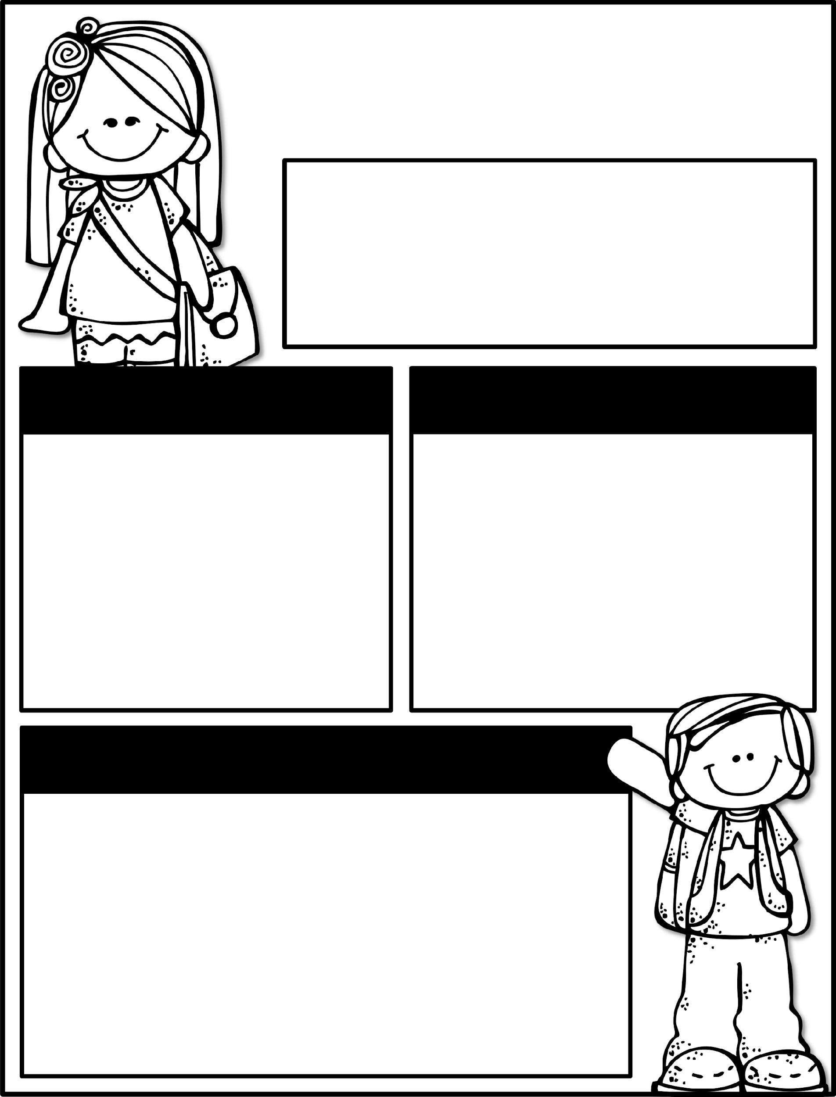

Kindergarten News
October 21-25, 2024
Class News
Learning Focus
Our field trip will be here before we know it! We have been checking background checks as they have come back. You will be notified by us if it has been received. We will keep you updated as they continue to come in. Adults without an approved background check from Henry County will not be able to chaperone. We are really looking forward to this trip! Remember that we are not able to take any child without a signed permission slip. We have lots of upcoming events happening. Please make plans to attend PTO’s Fall Festival. It was rescheduled for Friday, November 8th. If you are able to help in any way, please let PTO know!
Upcoming Events
Learning Focus
Vote for your favorite Ferst Reader Pumpkin this week! All money raised will support the Ferst Readers that provides books to preschoolers!
10/25- Pink Out Day $2 donation
10/28-11/1 Red Ribbon Week
10/30- Fall Picture Retakes
11/4 - Field Trip
11/5 - No School for students
11/8 - Fall Festival
Birthdays
Reading: Asking and answering questions about key details, characters, and setting of the text
Writing: Informational text
Math: Identifying and writing numbers 0-20
Phonics: Letters / Letter sounds / Blending to read and write words
Social Studies: Christopher Columbus
Sight Words to practice
a, the, as, to, do, I, is, am, at, an, man, in, it, was, you, from , your, said
Contact Me:
School Phone Number: 770-898-7362
Reminders
Please check your child’s binder each night. Check Dojo each night.
No child will be allowed to go on the Field Trip without a signed permission slip.
Please send a water bottle and daily snack for your child.
Please keep a change of clothing in your child’s bookbag for accidents.
We have completed the GKIDS assessments. This measures what your child knows entering kindergarten. Your child’s report will be his/her first report 9-week report card. It will be coming home in Monday Folders.

